Slide 1
Computer Programming I
Course Lecturers: Mr. Bello Moses Eromosele

Slide 2
Computer Programming I
The aim of the course is to give you a thorough and practical introduction to computer programming
C++ programming language are our tools of choice to achieve this aim
Choice of IDE: Visual Studio Code and DEV C++,

Slide 3
Computer Programming I
At the end of this course you should be able to
Demonstrate an understanding of computer programming language concepts
Define data types and use them in simple data processing applications
Understand the concept of pointers, declarations, initialization, operations on pointers, and their usage.
Understand and apply the concept of array, union, and enumeration user-defined data types
Demonstrate an understanding of threading and concurrency
Demonstrate an understanding of resource management
Develop C++ and Java programs

Slide 4
Brief History of C++
C++ was developed by Bjarne Stroustrup in 1983
C++ is an improvement of C programming language
It improved on C by adding a number of new features, the most important of which was classes
C++ is a multi- paradigm programming language that supports objected oriented programming

Slide 5
Brief History of Java
Java Programming Language was conceived by James Gosling, Patrick Naughton, Chris Warth, Mike Sheridan and Ed Frank.
They all worked for Sun Microsystems, Inc and came up with Java in 1991.
The language had a initial name as "Oak" and was renamed to Java in 1995
Java was necessary because C and C++ were not platform-independent as there programs have to be compiled for particular hardware before execution.

Slide 6
Who is using C++ Programming Language
C++ is used in different sectors of the software industry.
Apple OS is written in C++.
Windows 95, 98, Me, 200, and XP are written in C++.
Microsoft Office, Internet Explorer, and Visual Studio are written in Visual C++.
Google search engine and Chromium Web Browser are written in C++.

Slide 7
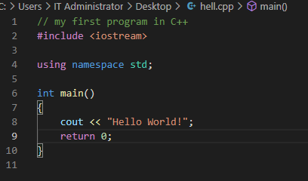
Structure of a C++ program

Slide 8
Structure of a C++ program
// my first program in C++: is a comment line. C++ comments come in two types:
Single-line comments are accomplished using a double slash (//) . The double slash tells the compiler to ignore everything that follows, until the end of the line.
Multiline comments are started by using a forward slash followed by an asterisk (/*).
#include <iostream>: is a header tag. All lines beginning with a hash sign (#) are directives for the preprocessor. In this case the directive #include tells the preprocessor to include the iostream standard file.

Slide 9
Structure of a C++ program
using namespace std; All the elements of the standard C++ library are declared within what is called a namespace, the namespace with the name std. So in order to access its functionality we declare with this expression that we will be using these entities. Without this declaration the expression
cout << "Hello World!";
would be written as
std::cout << "Hello, World!\n";
The std:: specifies that the name cout is to be found in the standard-library namespace

Slide 10
Structure of a C++ program
int main () :This is the main function. The main function is the point by where all C++ programs start their execution. The word main is followed in the code by a pair of parentheses () and right after these parentheses we can find the body of the main function enclosed in braces ({}).
cout << "Hello World!"; This statement prints Hello World on the screen
return 0; The return statement causes the main function to finish. return may be followed by a return code (in our example is followed by the return code 0)

Slide 11
Data types (Variable and constants)
Data types in C++ are classified into following categories:
*
Built-in types
User-defined types
*

Slide 12
Data types (Variable and constants) C++ and Java
Data types in C++ are classified into the following categories:
C++ Data Types
Built-in Types
User Defined Types
Integral type
Floating Type
Void
int
Char
Float
Double
Structure
Union
Class
Enum
Data types in C++ are similar to those in Java but in Java String Datatype was introduced

Slide 13
Built-in (Primitive)Data types
Integer: This data type is used to store integer values. It has three size modifiers that may go along with it: short, int and long
int a = 123456789;
int b = 123456789;
int c = a + b;
short d = 1234;
short e = 1234;
short f = d + e;
long g = 123456789;
long h = 123456789;
long i = g + h;

Slide 14
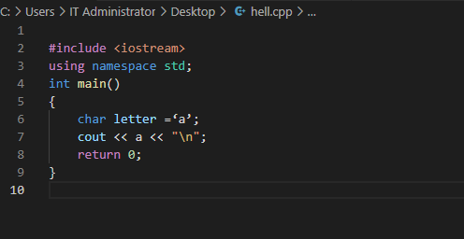
Built-in (Primitive)Data types
Character: This data type is used for storing characters, which may be any single character. It may also include a letter, a digit, a punctuation mark, or space. The keyword for this data type is char.

Slide 15
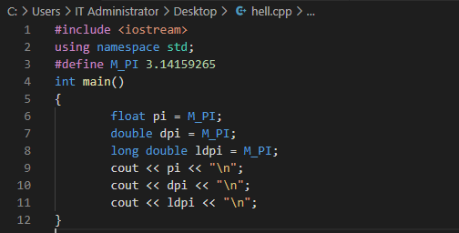
Built-in (Primitive)Data types
Floating point: This data type is used for storing single precision floating point values or decimal values. Its keyword is float or double

Slide 16
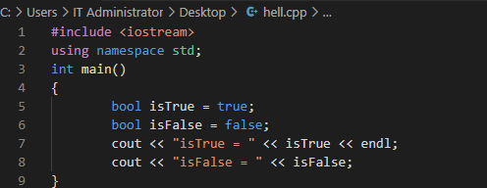
Built-in (Primitive)Data types
Boolean: This is used for storing Boolean or logical values. Any variable with this data type can store either true or false. Its Keyword is bool.

Slide 17
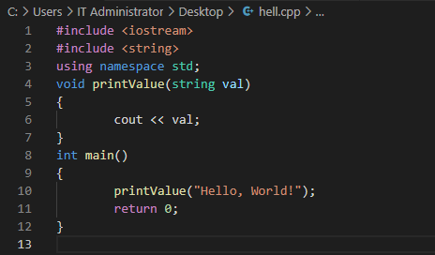
Built-in (Primitive)Data types
Void: Specified by void keyword, this data type is without any value.

Slide 18
Built-in (Primitive)Data types
The list of all the built-in data types with each modifier and their range is given in the following table.
Group | Type names | Range/Size
Character types | Char | Exactly one byte in size. At least 8 bits.
 | char16_t | Not smaller than char. At least 16 bits.
 | char32_t | Not smaller than char16_t. At least 32 bits.

Slide 19
Built-in (Primitive)Data types
The list of all the built-in data types with each modifier and their range is given in the following table. (Note the Size depends on the architecture of the computer)
Group | Type names | Range/Size
Integer types (signed) | signed char | Same size as char. At least 8 bits.
 | signed short int | Not smaller than char. At least 16 bits.
 | signed int | Not smaller than short. At least 16 bits.
 | signed long int | Not smaller than int. At least 32 bits.
 | signed long long int | Not smaller than long. At least 64 bits.

Slide 20
Built-in (Primitive)Data types
The list of all the built-in data types with each modifier and their range is given in the following table.
Group | Type names | Range/Size
Floating-point types | Float | 4bytes or 32 bits
 | Double | Precision not less than float
 | long double | Precision not less than double
Boolean type | Bool | 8 bits
Void type | Void | no storage

Slide 21
Variable Name (Identifier)
A valid identifier or variable name is a sequence of one or more letters, digits or underscore characters (_).
A variable name can begin with a letter or an underline character (_ )
Only letters, digits and single underscore characters can be used for a variable name
Neither spaces nor punctuation marks or symbols can be part of an identifier.
A variable name should not be a keyword
Examples of valid variable names:
int a; bool ripe; float gpa;
NOTE: The C++ language is a "case sensitive" language. That means that an identifier written in upper case letters is not equivalent to another one with the same name but written in lower case letters. For example, a variable CGPA is not the same as Cgpa or cgpa.

Slide 22
Compound Statement (Block)
What is a statement: A statement is an executable line of code, eg.
int a=2;
int b=4;
A compound statement (also called a block, or block statement) is a group of zero or more statements that is treated by the compiler as if it were a single statement.
Blocks begin with a { symbol, end with a } symbol, with the statements to be executed being placed in between. Example of a compound statement
{
int a=2;
int b=4;
}

Slide 23
Scope and Lifetime of a Variable
A variable can be either of global or local. A global variable is a variable declared in the main body of the source code, outside all functions, while a local variable is one declared within the body of a function or a block.
The global variable is visible anywhere within the program while the local variable is only visible within the block or function.

Slide 24
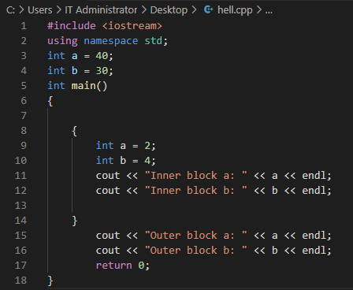
Scope and Lifetime of a Variable
Let’s consider the following example:

Slide 25
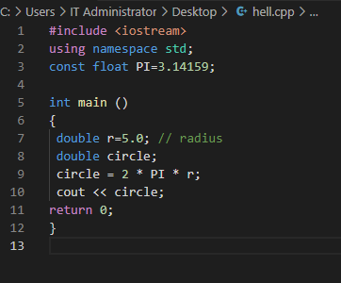
Constants
Constants has a fixed value and their value does not change during program execution.

Slide 26
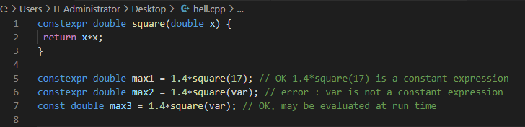
Constants
constexpr
This is used primarily to specify constants that are computed by the compiler at compilation time. The value is stored in a read-only memory.

Slide 27
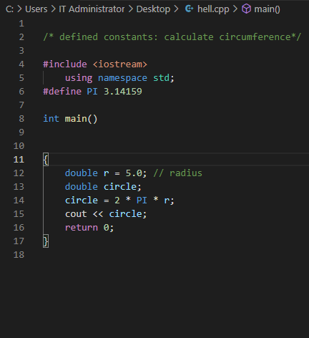
Constants
Constant can also be defined using the #define preprocessor directive.
Its format is:
#define identifier value

Slide 28
Literals
Literals are used to express particular values within the source code of a program.
Literal constants can be divided in Integer Numerals, Floating-Point Numerals, Characters, Strings and Boolean Values.
Floating point literals: 3.14159 , 6.02e23 , 1.6e-19
Integer literals: 9,8,-1,0
Boolean literals: true, false
Character literals : ‘k’, ‘l’, ‘a’
String literals: “My car”, “Computer programming I”

Slide 29
Escape Codes
These are special characters that are difficult or impossible to express in the source code of a program. Given below is a list of some escape codes
Code | Function
\n | New line
\r | Carriage return
\t | Tab
\v | Vertical table
\b | Backspace
\f | Form feed (page feed)
\a | Alert (beep)
\’ | Single quote(‘)
\” | Double quote (“)
\? | Question mark (?)
\\ | Backslash (\)

